Slide 1
CSE4421/5324: Introduction to Robotics

Slide 2
Contact Information
Burton Ma
CSEB 1012J (near the north-east entrance)
burton@cse.yorku.ca
CSE4421/5324
lectures Monday, Wednesday, Friday 2:30-3:30PM (CB)
labs Thursday 11:30-1:30, weeks 1-6 (Prism 1006B)
www.cse.yorku.ca/course/4421
(web site not live yet)

Slide 3
General Course Information
The course introduces the basic concepts of robotic manipulators and autonomous systems. After a review of some fundamental mathematics the course examines the mechanics and dynamics of robot arms, mobile robots, their sensors and algorithms for controlling them.
two robotic arms
everything in Matlab (and some Java)
required textbook
  Thrun, Burgard and Fox, Probabilistic Robotics, The MIT Press, 2006
other references
  see course web page

Slide 4
Labs
six 2-hour labs
  Thursday 11:30-1:30 in Prism CSEB1006B
  the first two labs are very important as they are where you learn how to use the two robotic arms
    Lab 1 Jan 12
    Lab 2 Jan 19
    Lab 3 Jan 26

Slide 5
Assessment
4 assignments worth 20% each
  mix of theory and implementation
  first two will use the robotic arms
  last two will be related to mobile robotics
  graduate students have additional questions on the assignments
exam worth 20%

Slide 6
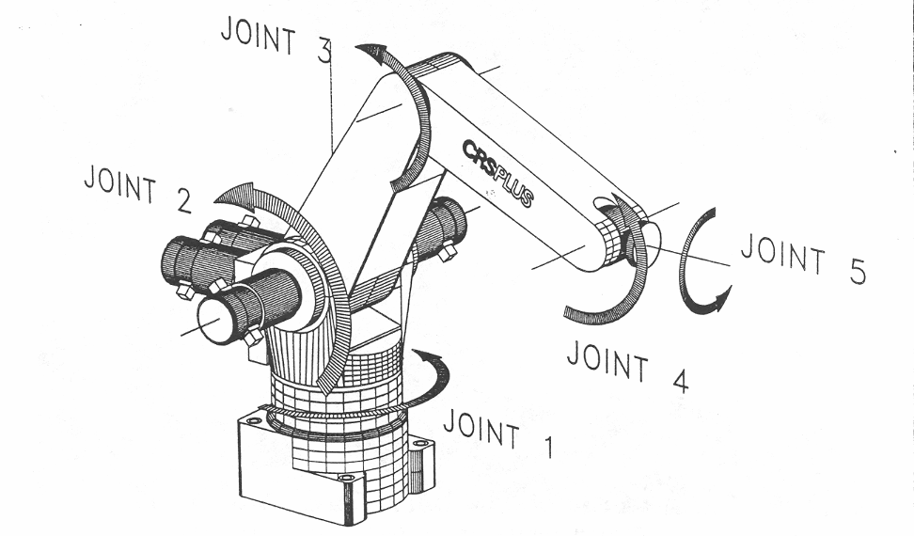
A150 Robotic Arm
link 3
link 2

Slide 7
Kinematics
the study of motion that ignores the forces that cause the motion
  “geometry of motion”
interested in position, velocity, acceleration, etc. of the various links of the manipulator
  e.g., where is the gripper relative to the base of the manipulator? what direction is it pointing in?
  described using rigid transformations of the links

Slide 8
Kinematics
forward kinematics:
  given the link lengths and joint angles compute the position and orientation of the gripper relative to the base
    for a serial manipulator there is only one solution
inverse kinematics:
  given the position (and possibly the orientation) of the gripper and the dimensions of the links, what are the joint variables?
    for a serial manipulator there is often more than one mathematical solution

Slide 9
Wheeled Mobile Robots
robot can have one or more wheels that can provide
  steering (directional control)
  power (exert a force against the ground)
an ideal wheel is
  perfectly round (perimeter 2πr)
  moves in the direction perpendicular to its axis

Slide 10
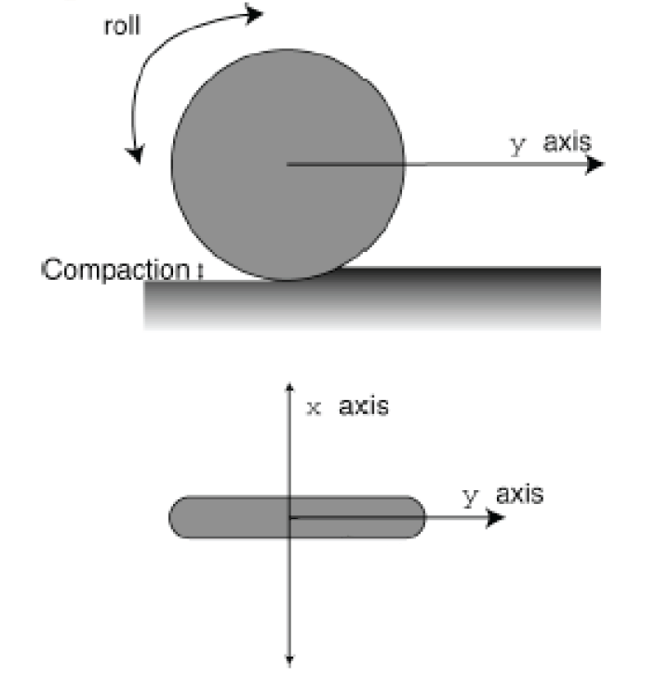
Wheel

Slide 11
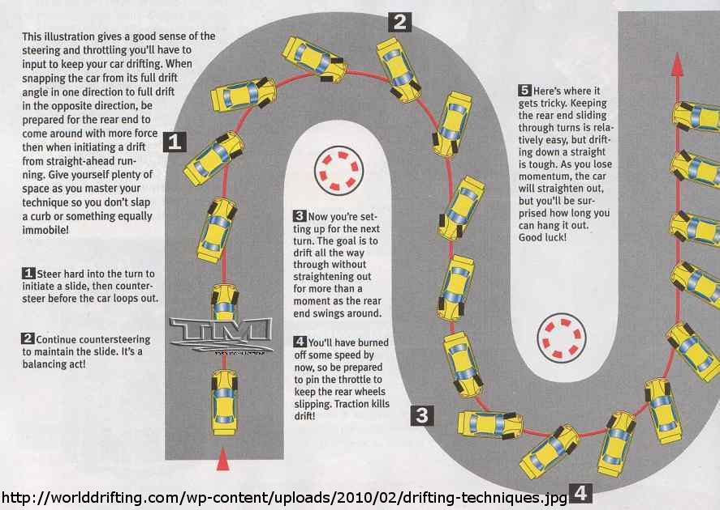
Deviations from Ideal

Slide 12
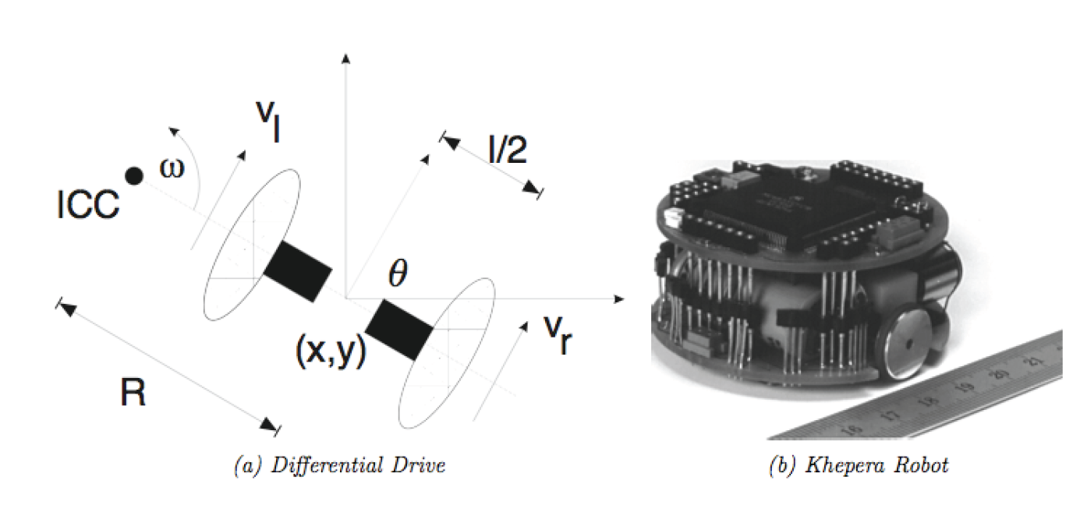
Differential Drive
two independently driven wheels mounted on a common axis

Slide 13
Forward Kinematics
for a robot starting with pose [0 0 0]^{T} moving with velocity V(t) in a direction θ(t) :

Slide 14
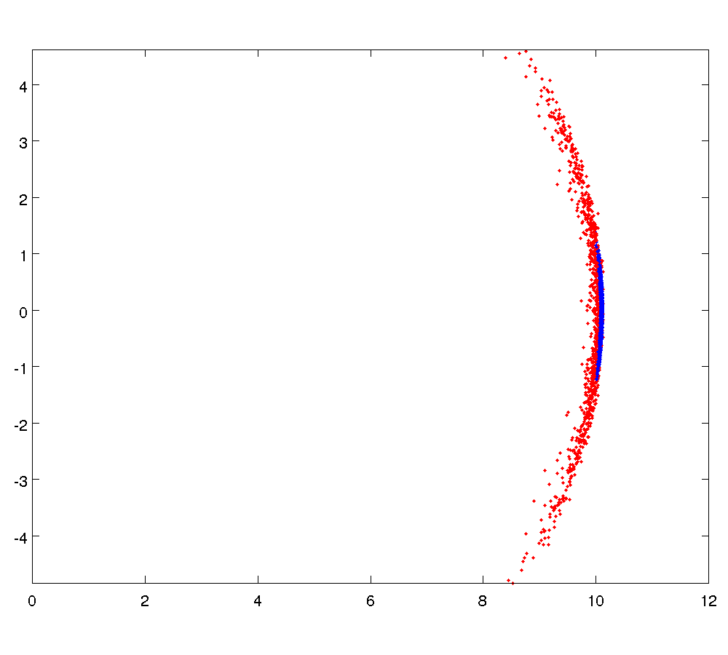
Sensitivity to Wheel Velocity
σ = 0.05
σ = 0.01

Slide 15
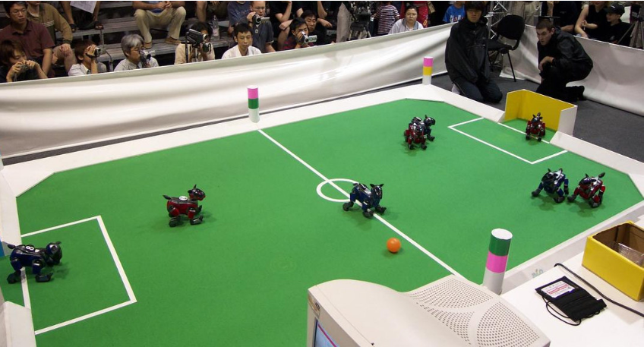
Localization using Landmarks: RoboSoccer

Slide 16
Maps
 |  |  |  |  |  |  |  |  |  |  |  |  |  |  | *
*
goal
start

Slide 17
Path Finding
goal
start

Slide 18
Localization
goal
start

Slide 19
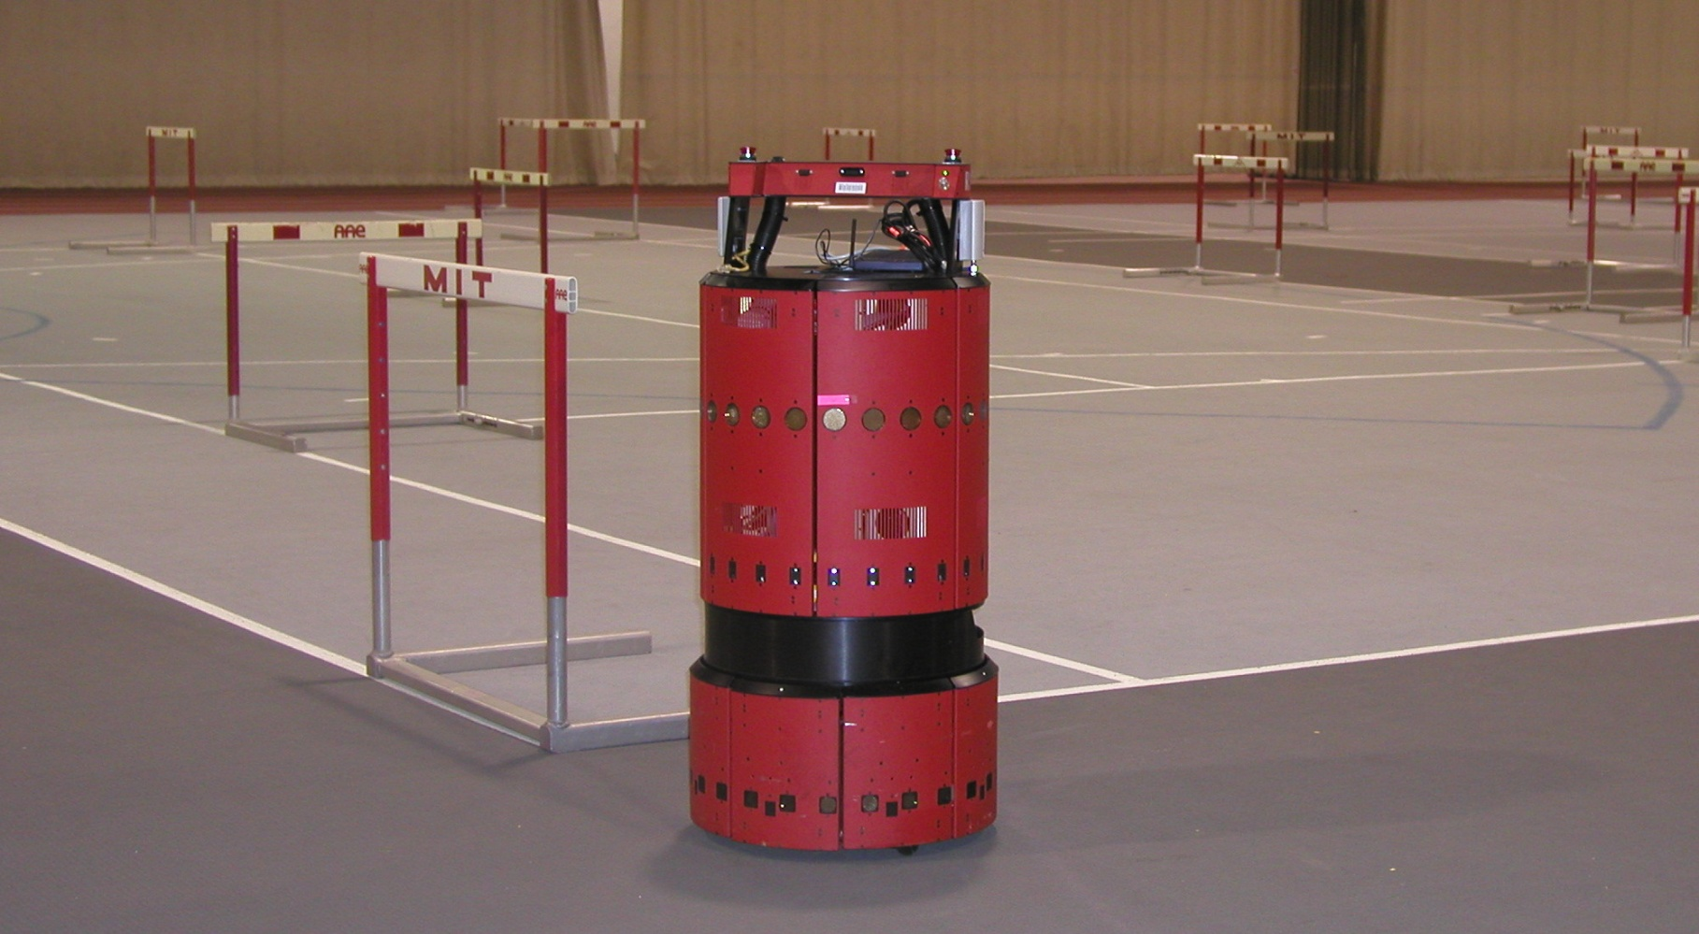
EKF SLAM Application
www.probabilistic-robotics.org
[MIT B21, courtesy by John Leonard]

Slide 20
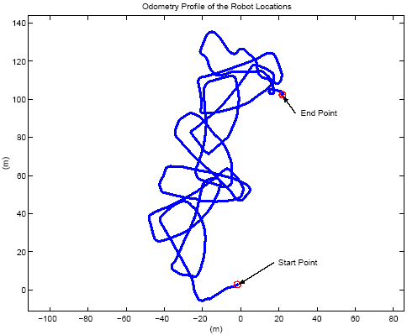
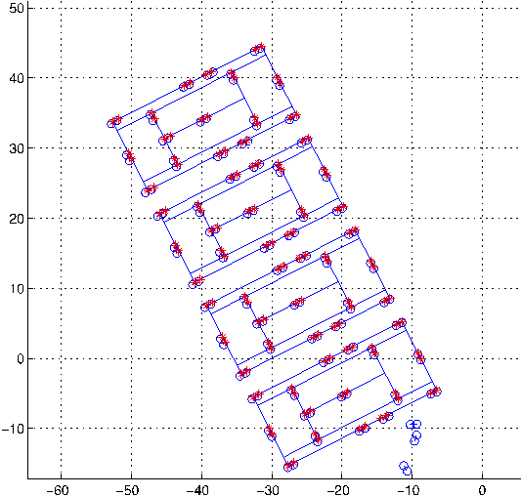
EKF SLAM Application
raw odometry
estimated trajectory
www.probabilistic-robotics.org
[courtesy by John Leonard]

